Slide 1
QC of raw reads (FastQC)
DK
Notes:
Keep it practical: where to get data, how to download it, and first checks with FastQC/MultiQC.

Slide 2
First: Install FastQC and MultiQC
Ubuntu (system packages)
sudo apt update
sudo apt install -y default-jre
sudo apt install -y fastqc
sudo apt install -y multiqc
Mac
brew install fastqc multiqc
If throws java error (brew install openjdk)
fastqc --version
multiqc –version
Run: multiqc .

Slide 3
Second: download raw sequencing data:
cd into directory of your choice.
Command:
rsync -vaz dikeledi.kekana@10.10.24.232:/home/dikeledi.kekana/Influenza_fastQC/ .
Password: ReViNa2025
ls to check if files have been downlaoded

Slide 4
FastQC
FastQC provides a simple way to do some quality control checks on raw sequence data coming from high throughput sequencing
Provides a modular set of analyses which you can use to give a quick impression of whether your data has any problems you should be aware before doing any further analysis
The main functions of FastQC are
Import of data from BAM, SAM or FastQ files (any variant)
Providing a quick overview to tell you in which areas there may be problems
Summary graphs and tables to quickly assess your data
Export of results to an HTML based permanent report

Slide 5
FastQC
Graphic User Interface (GUI) or Desktop version available here: https://www.bioinformatics.babraham.ac.uk/projects/fastqc/
Also available online on Galaxy:
https://usegalaxy.org/?tool_id=toolshed.g2.bx.psu.edu%2Frepos%2Fdevteam%2Ffastqc%2Ffastqc%2F0.73%2Bgalaxy0&version=0.73%20galaxy0
Run: fastqc *.fastq.gz

Slide 6
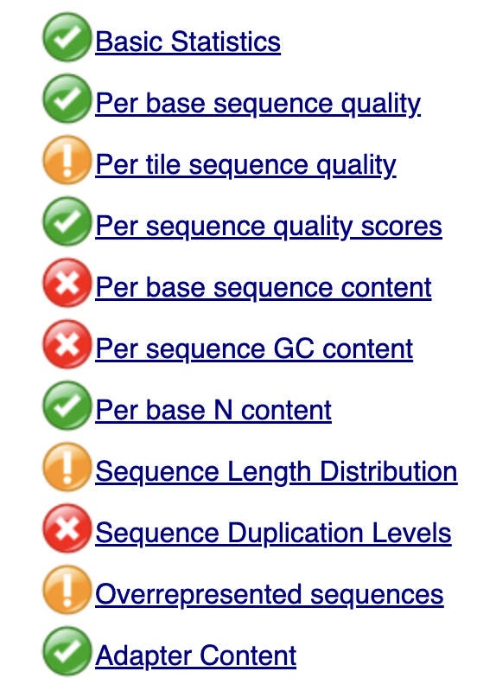
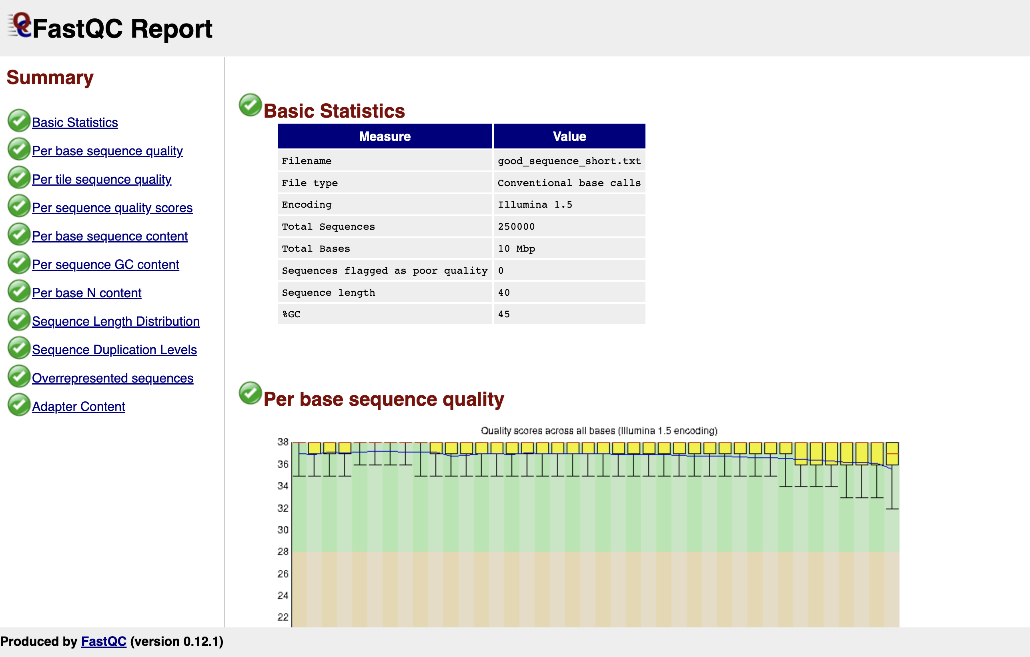
Can also look like that
Summary of QC categories evaluated by FastQC

Slide 7
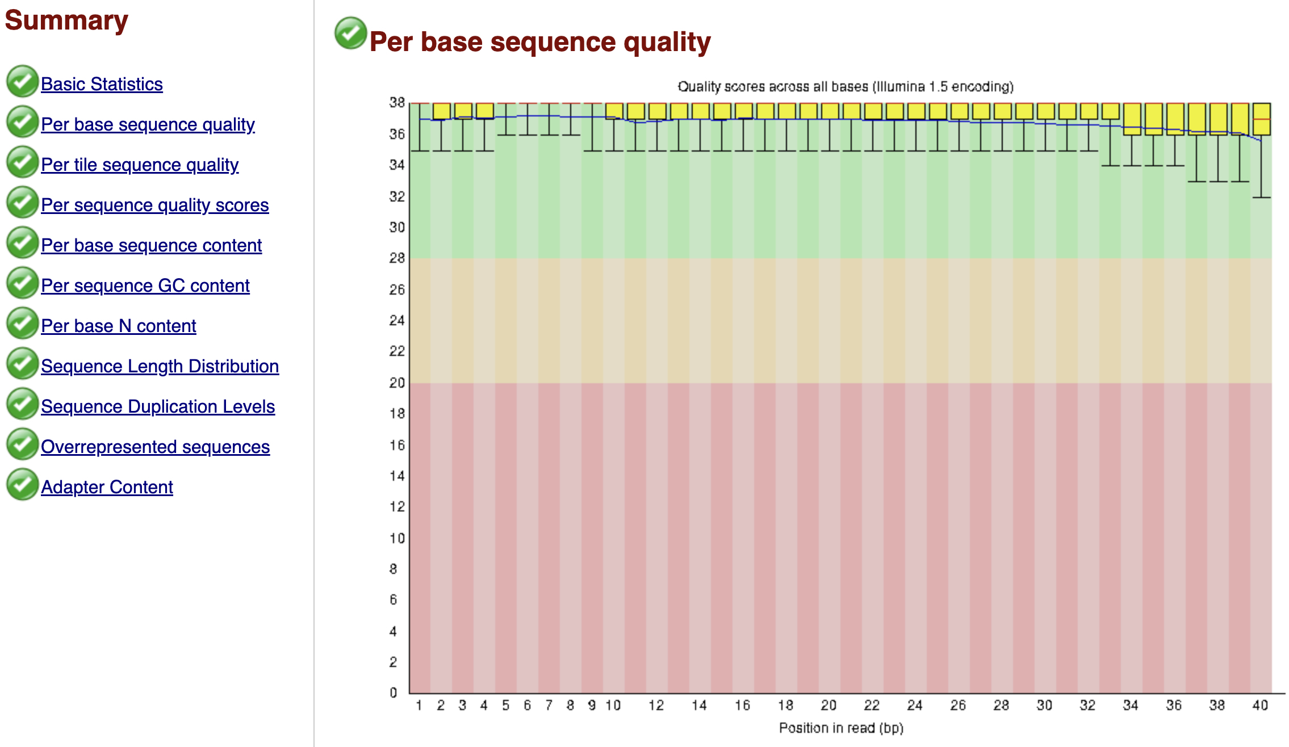
Good
Good
Reasonable
Bad
Shows the average quality (Phred) score at each position

Slide 8
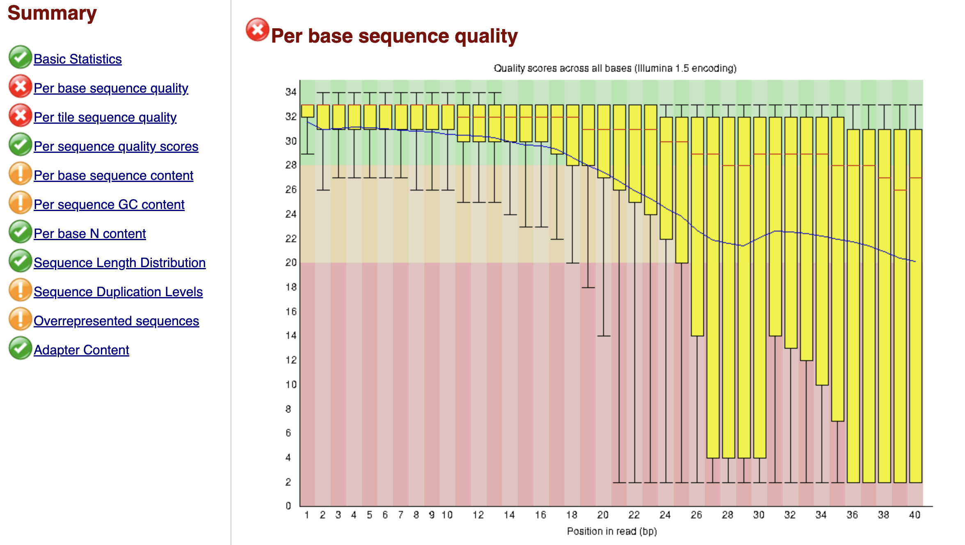
Bad

Slide 9
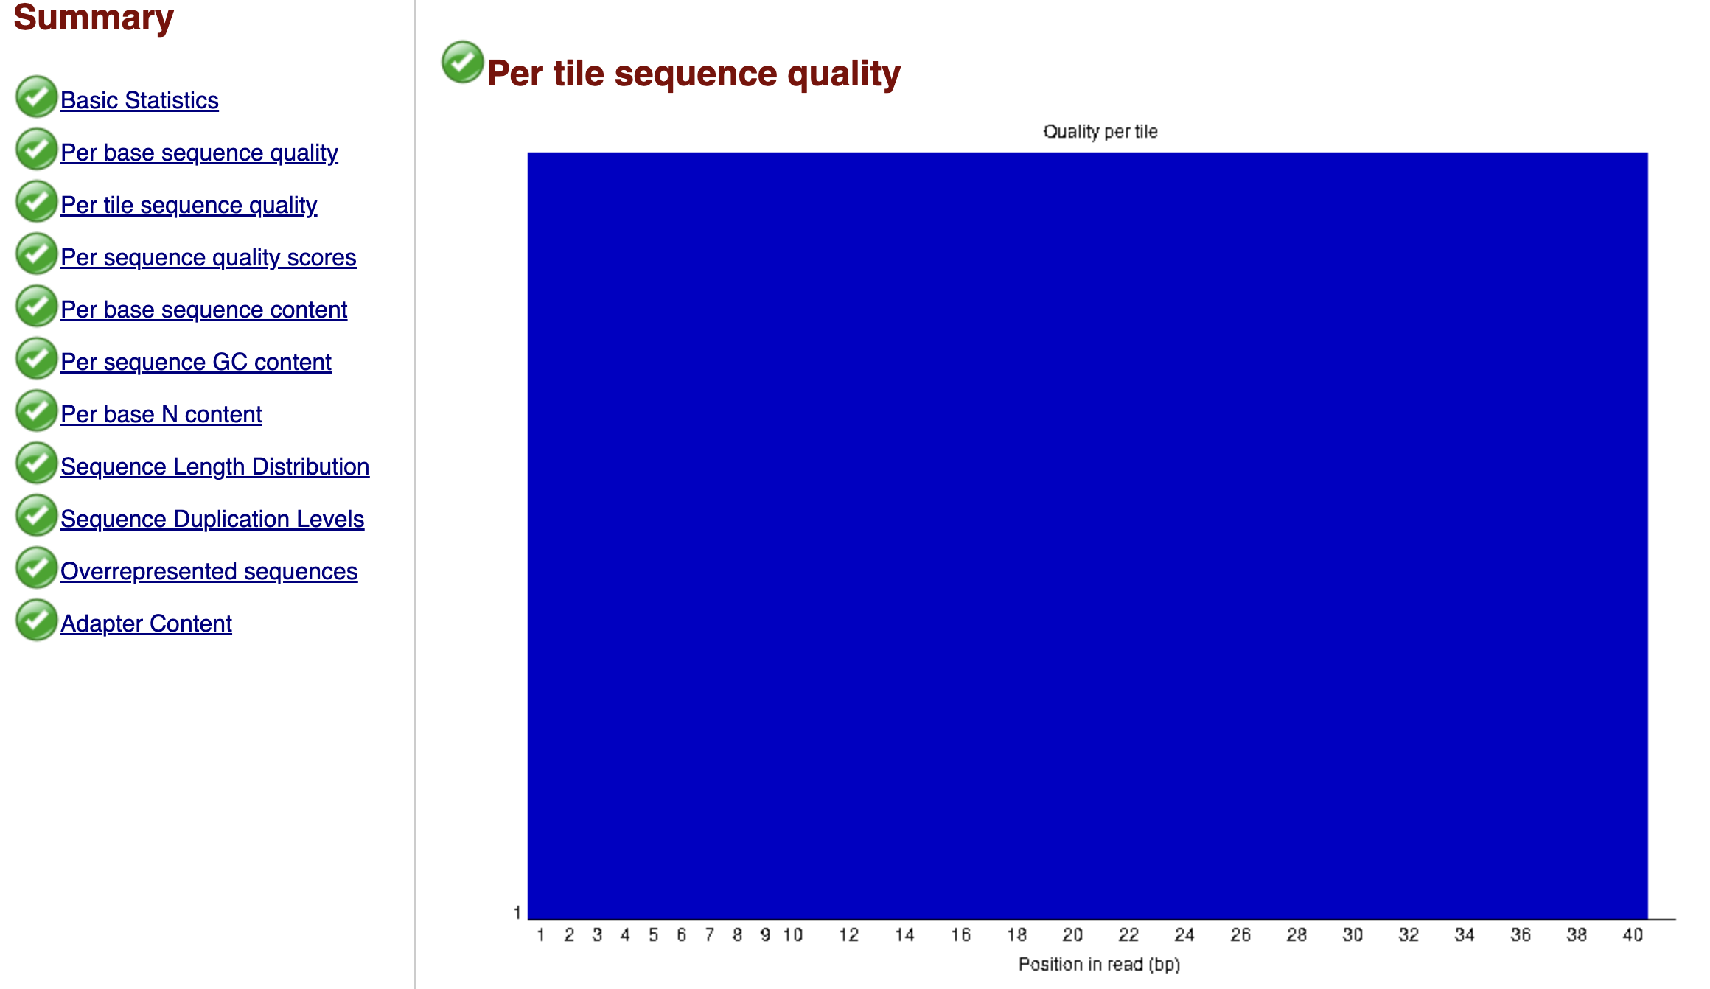
Good
Has to do with imaging on the chip

Slide 10
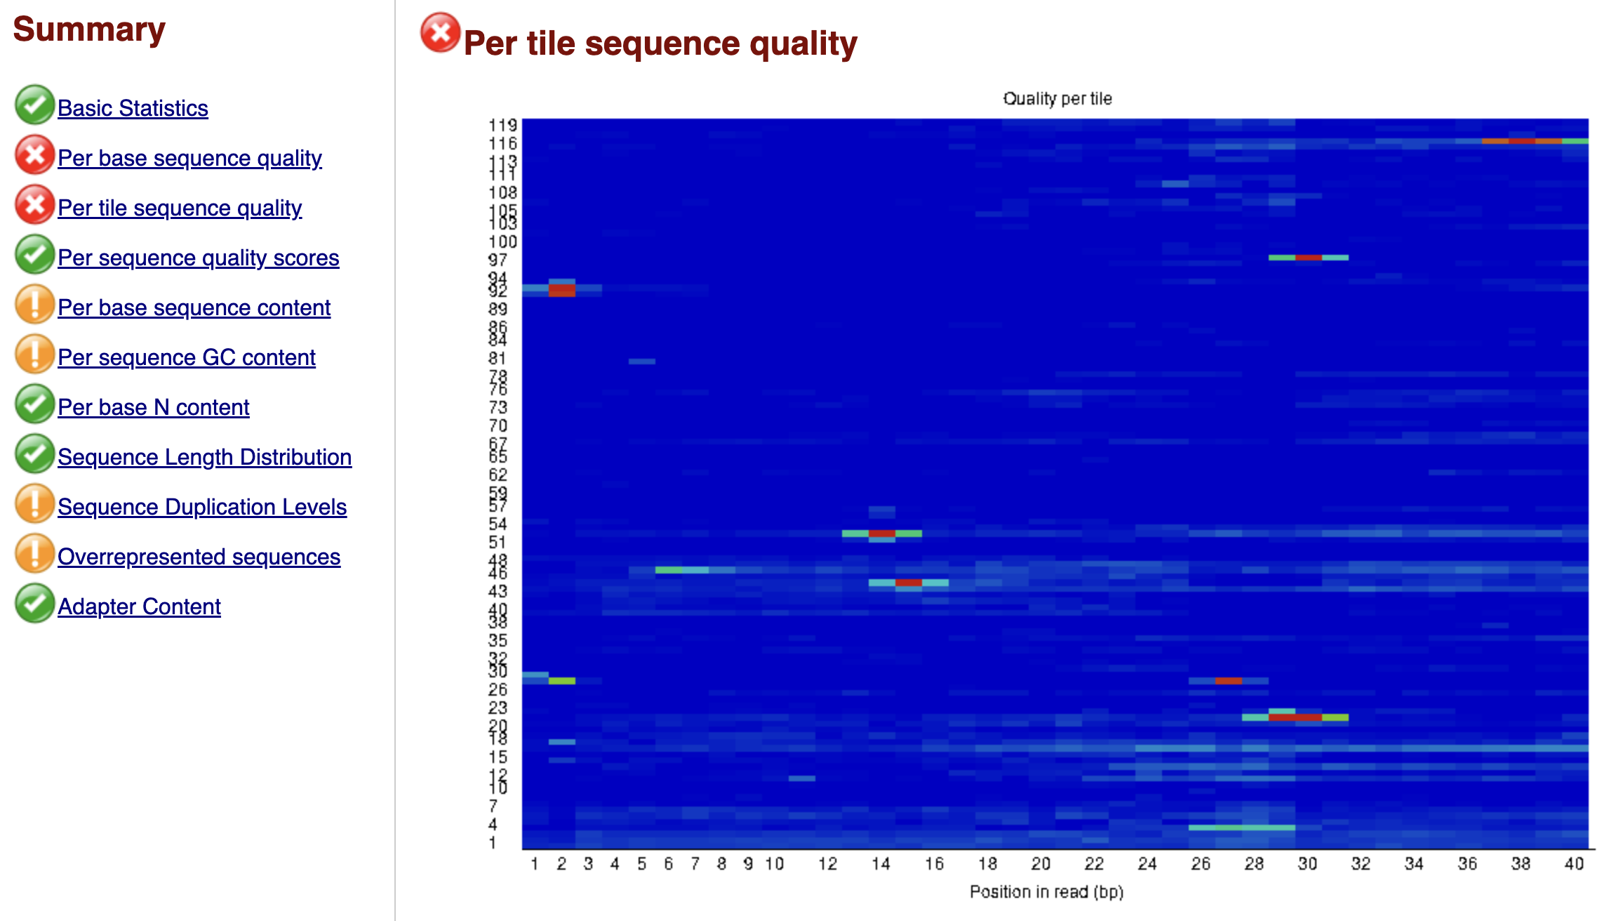
Not good

Slide 11
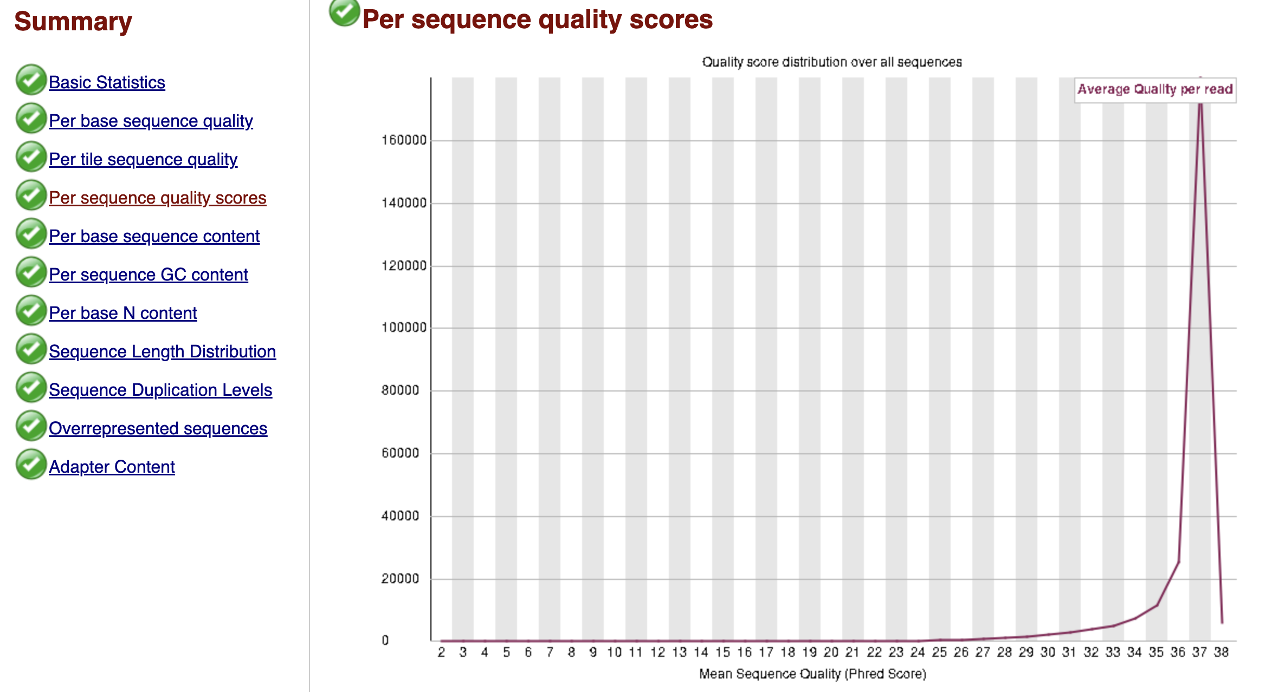
Good
Shows the average quality (Phred) score by reads

Slide 12
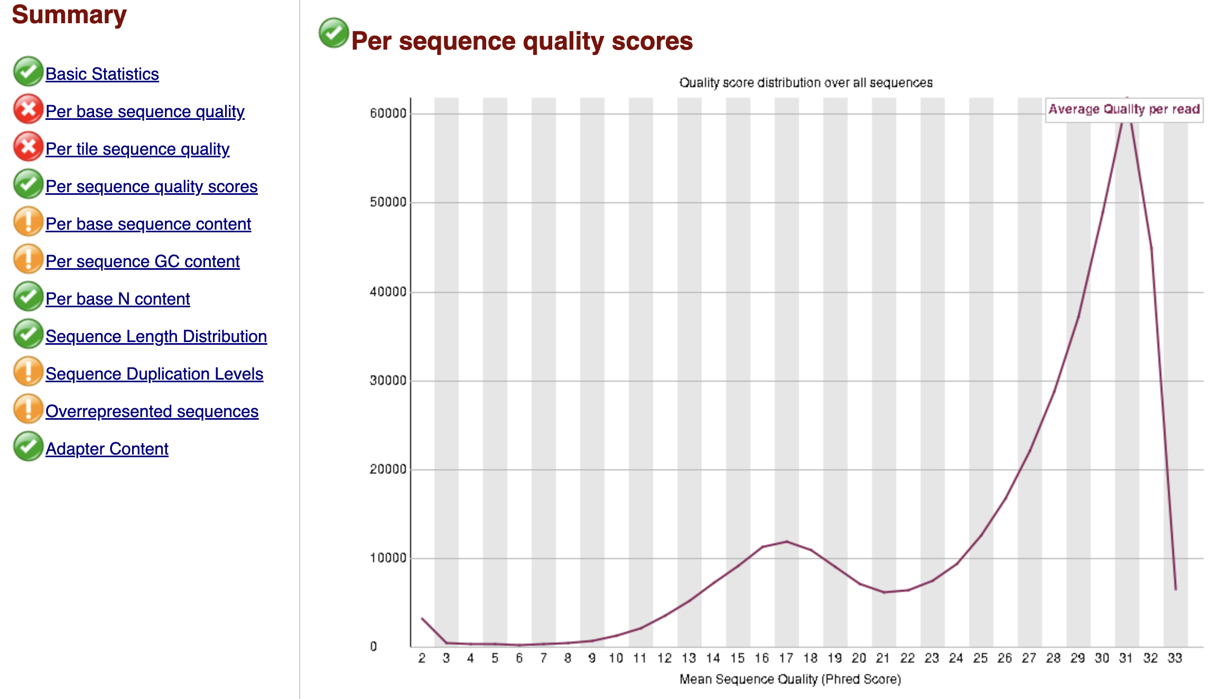
Not so good
May want to trim the low quality sequences

Slide 13
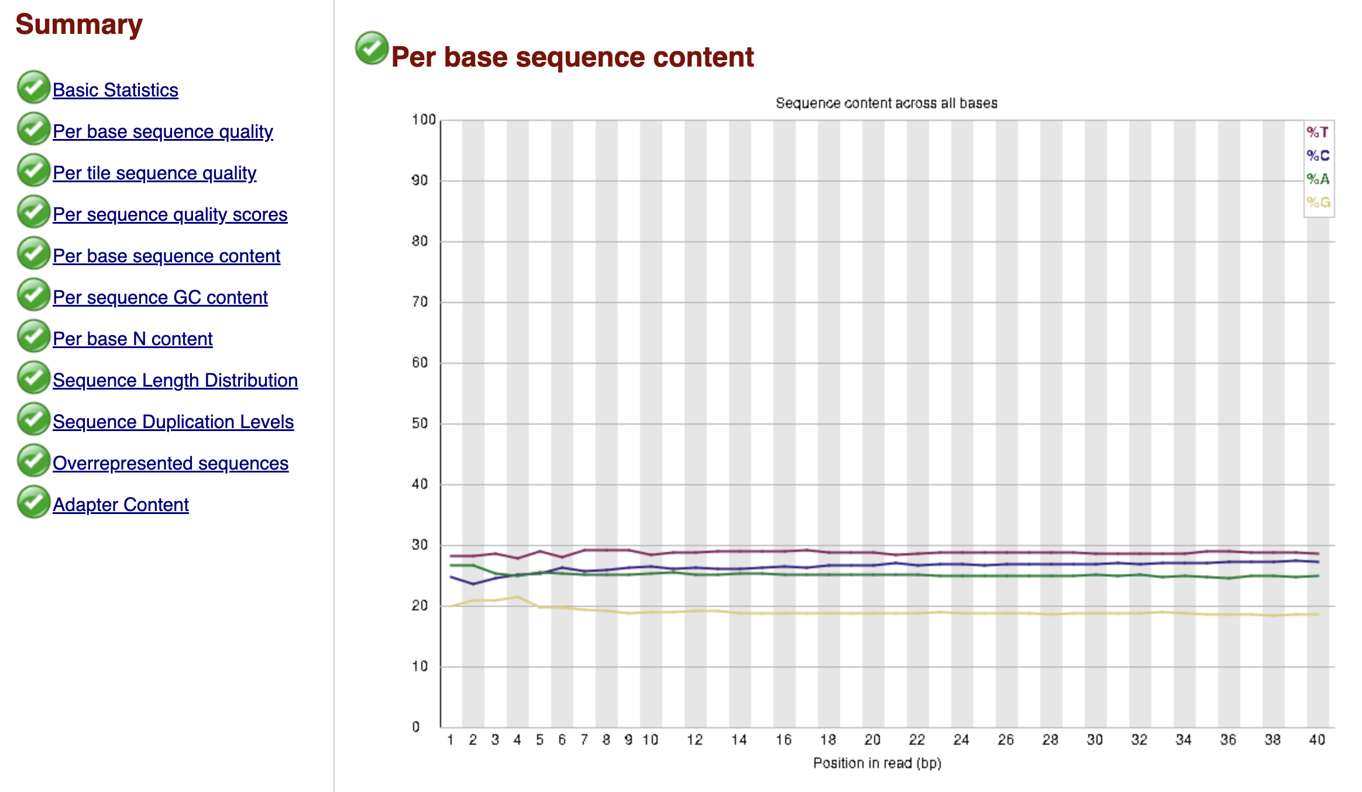
Good
In a random library, you expect your per base sequence content to be uniform – no overrepresentation of bases

Slide 14
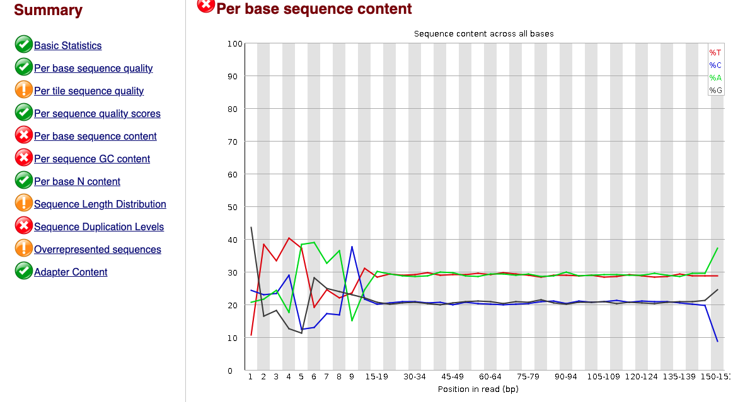
Not so good
May have some primers. Trim your sequences

Slide 15
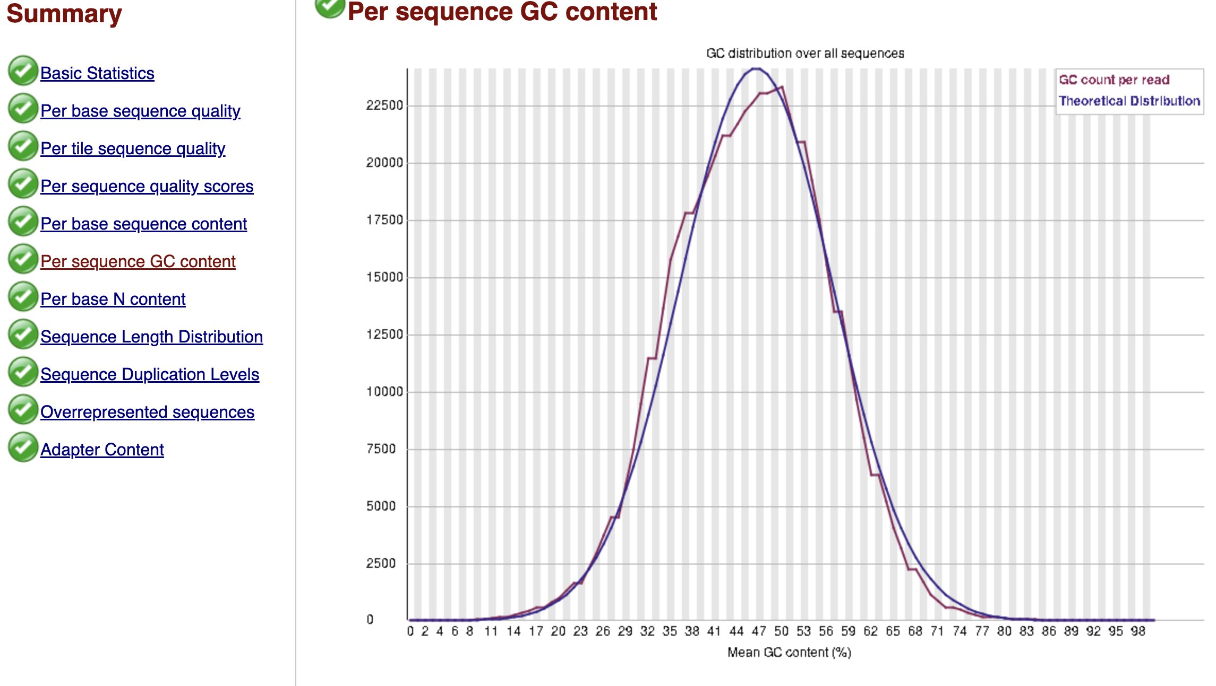
Good
Has to follow a normal distribution

Slide 16
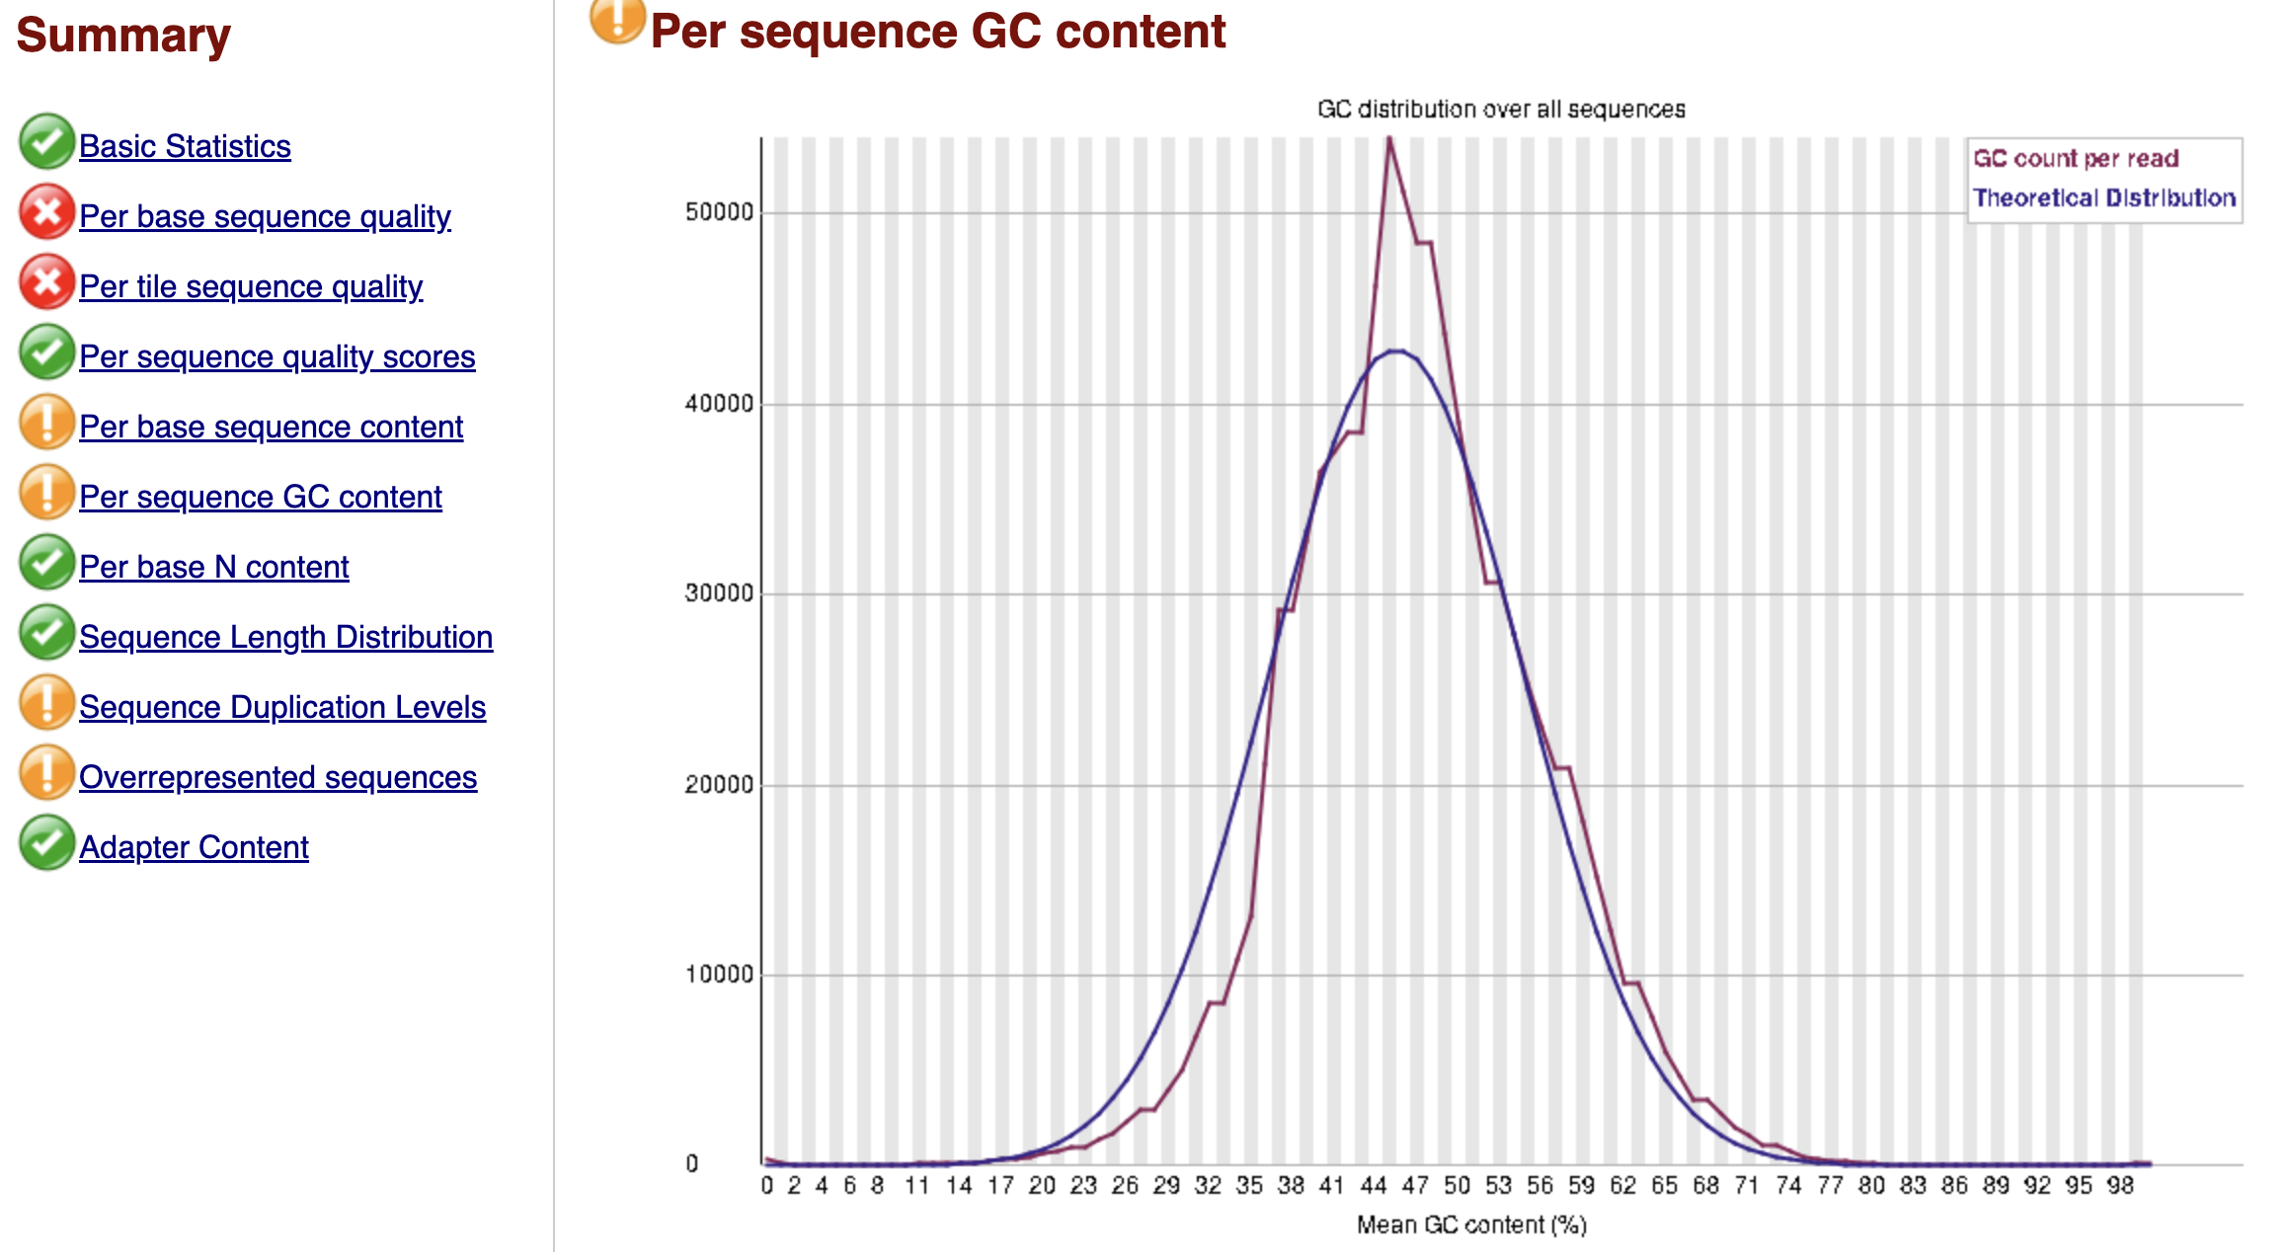
Not so good

Slide 17
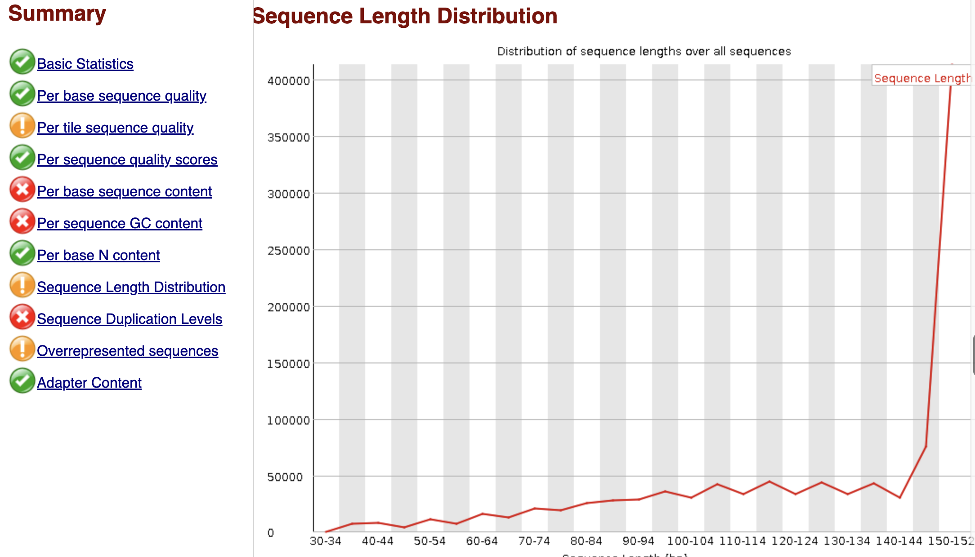
Okay

Slide 18
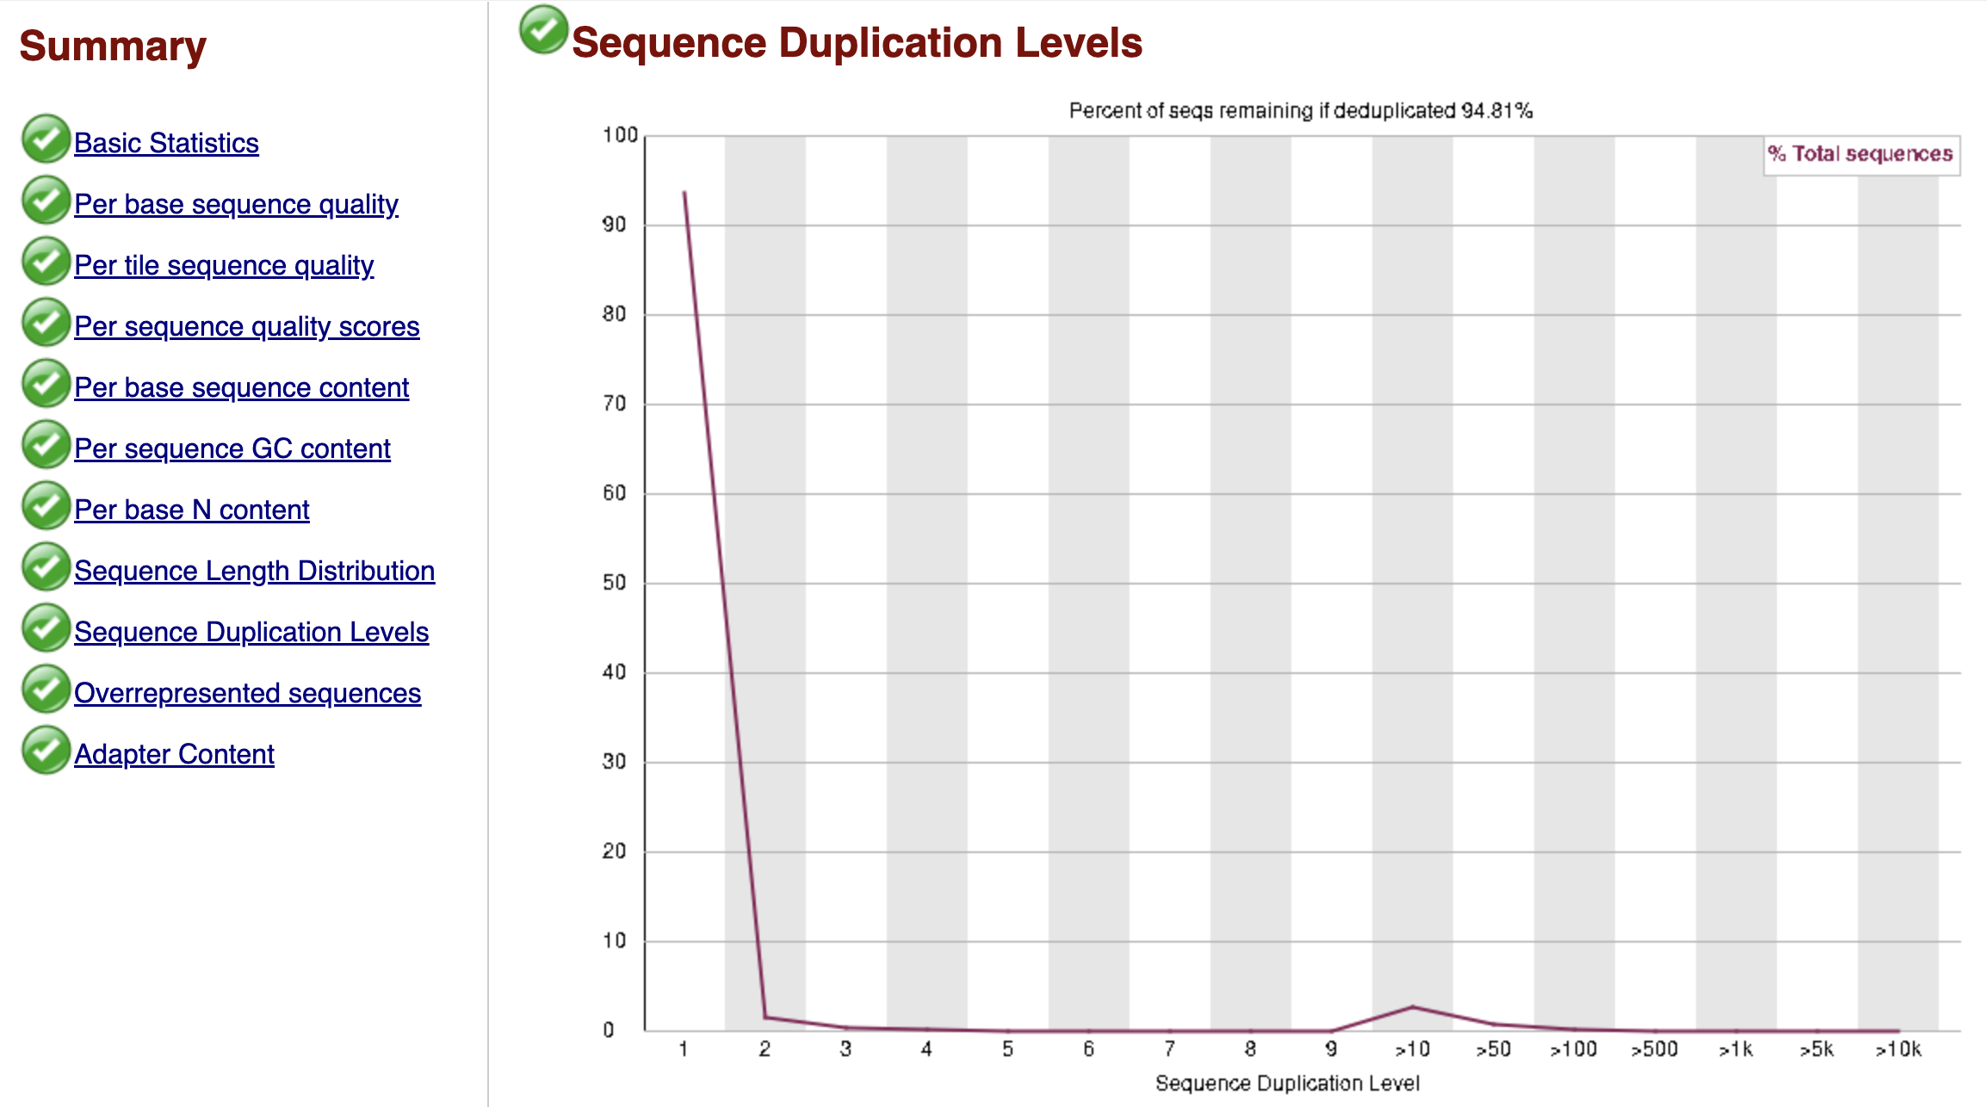
Good
Bias if there is a lot of duplication

Slide 19
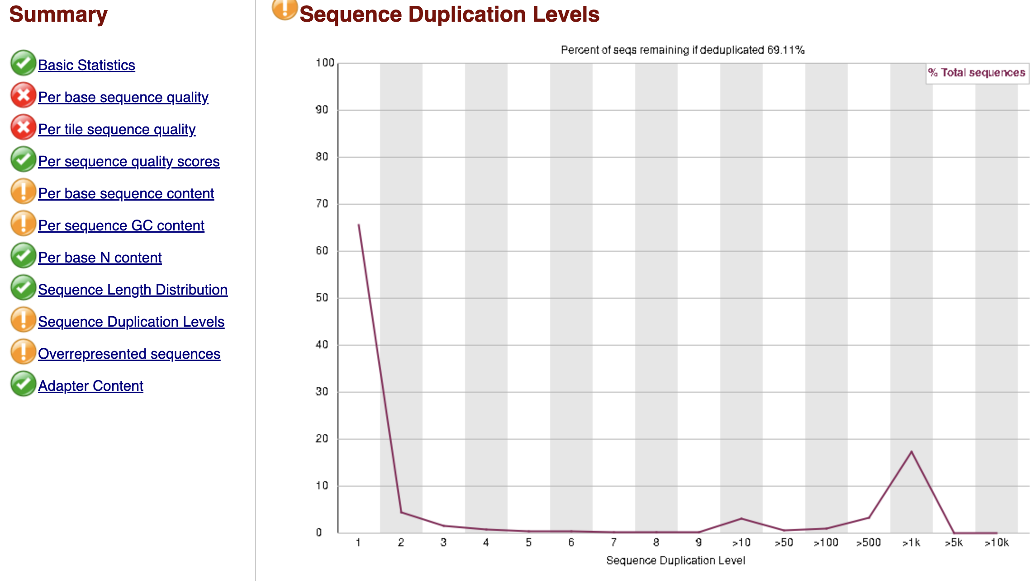
Not so good

Slide 20
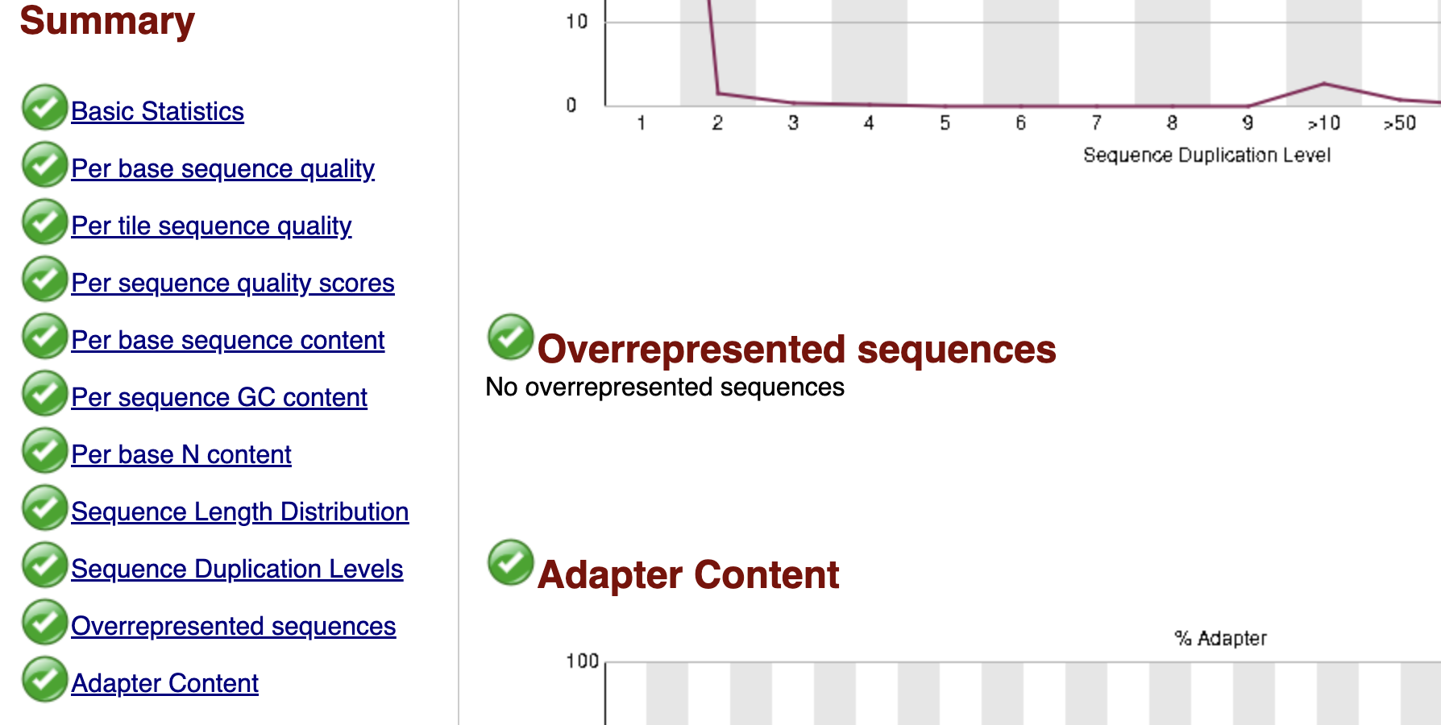
good

Slide 21
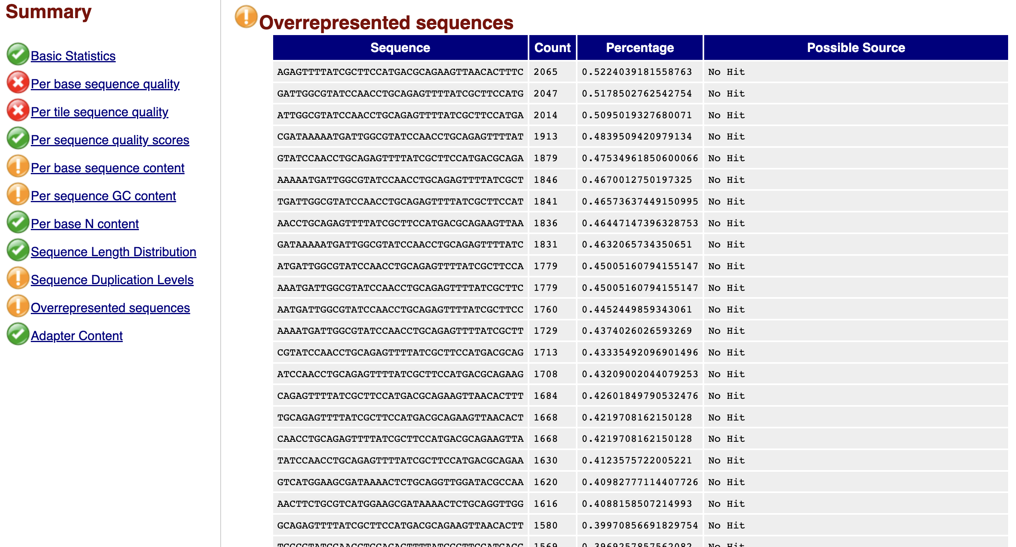
Duplication

Slide 22
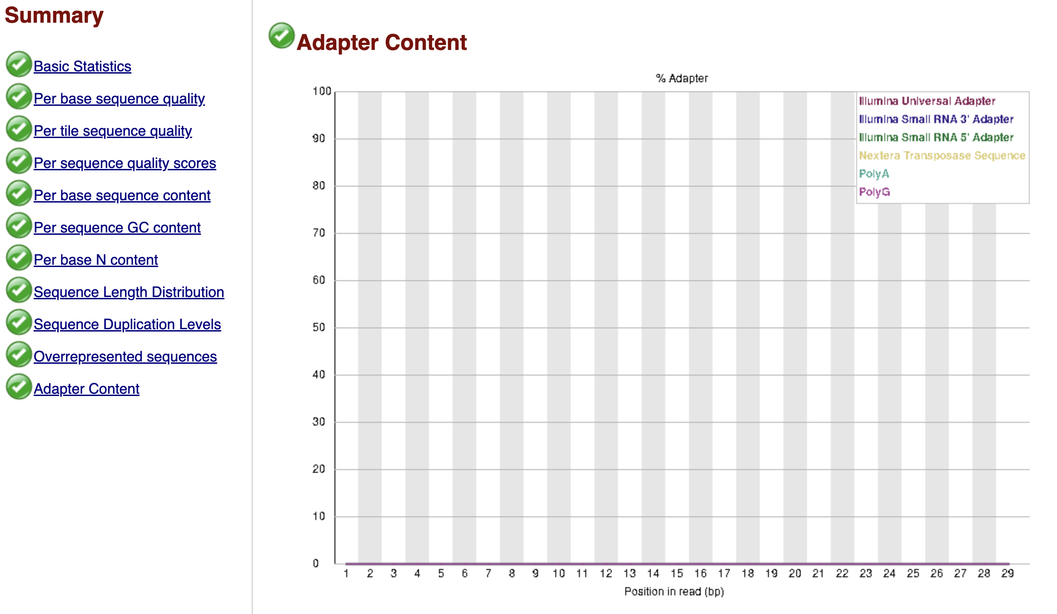
Good

Slide 23
Open FastQC + MultiQC results
macOS
Open in your default browser:
open path/to/report.html
Open with a specific browser:
open -a "Google Chrome" path/to/report.html
open -a "Safari" path/to/report.html
Ubuntu / Linux (Hopefully)
Open in your default browser:
sudo apt install xdg-utils
xdg-open path/to/report.html
Open with a specific browser:
firefox path/to/report.html &
google-chrome path/to/report.html &
Install browser
wget https://dl.google.com/linux/direct/google-chrome-stable_current_amd64.deb
Notes:
Open the FastQC HTML or the MultiQC summary to review all samples at once.

Slide 24
Interpreting common FastQC flags
Low per‑base quality at 3′ end → trim (e.g., fastp, Trimmomatic)
Adapter content detected → trim adapters, then re‑run FastQC
Weird GC distribution → possible contamination or biased library
High duplication → PCR bias or low complexity; check protocol
Notes:
After trimming, re‑run FastQC/MultiQC and keep both reports for records.

